Slide 1
Prediction of Wheat Yields Using Multiple Linear Regression Models in the Huaibei Plain of China
Beier Zhang (AIER - China )
Qinhan Dong (VITO - Belgium)

Slide 2
Contents
Study area
Phenology
Trends of yields
Data sets and methods
Results of prediction
Validation
Discussions

Slide 3
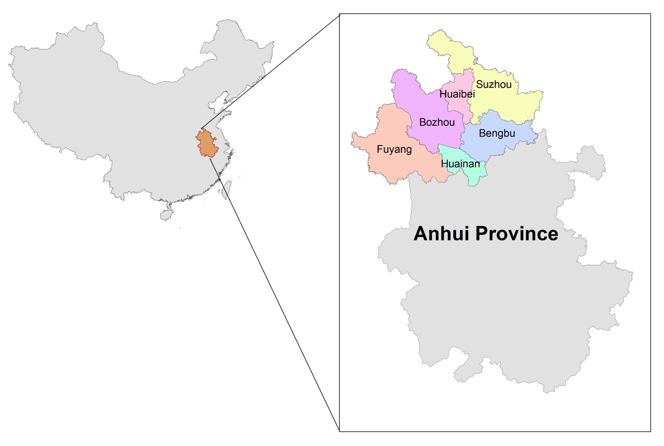
Study area
Huaibei Plain
(include 6 prefectures)
Area:64154 km²
Arable area: 20905 km²
Main soil type :Cambosols & Vertisols
Main crop type: Winter wheat & Maize

Slide 4
Phenology
Wheat: October to next year June
Sowing | Emergence | Tiller | Wintering period | Turning green | Jointing | Heading | Maturity | Harvest
10/12 | 10/19 | 12/1 | 12/20 | 2/10 | 3/10 | 4/22 | 5/15 | 6/1
Maize or soybeans: June to October

Slide 5
Trends of yields
There are significant yearly trend of wheat yield in every prefectures from 2000 to 2011, so the trend must be considered in the prediction

Slide 6
Data sets
I. Biophysical variables based on RS: using SPOT-VGT
Ten-daily series : every dekad from 1999 to 2011
Variables: Smoothed k-NDVI and y-DMP
Building data sets of RS:
The cumulative NDVI or DMP for all possible combinations (at least 2, at most 9, because the one phenological stage is less than 3 month) of consecutive dekads within the wheat growing period (2nd dekad of Oct to 3rd dekad of Jun).

Slide 7
Data sets
II. Chemical fertilizer input data sets
Why we need this data set
The reasons of the trend is the technology improvement. in our study area, chemical fertilizer input(CFI) is a most important factor of technology improvement. Chemical fertilizer input also have significant yearly trend
Variables: yearly chemical fertilizer input(1000 ton) of every prefecture, from 2000 to 2011

Slide 8
Data sets
III. Meteorology data sets
Variables: include rainfall, temperature and solar radiation, from 1999 to 2011
Interpolation method: CGMS Level-1 give us the values of every grid (25km x 25km) in the study area.
Calculate average values in every prefecture
Building data sets of Meteorology data sets:
The average rainfall, temperature and solar radiation of every phonelogical stage of wheat in every prefecture.

Slide 9
Methods
Multiple Linear Regression
Using ΣNDVI and CFI as variables
Using ΣDMP and CFI as variables
Adding meteorology data as variables
Jack-knife
Leave-one-out (leave one year data out; regression model building using the rest of data to predict the left year; corellating the official yield with the predicted ones)

Slide 10
Results
Regression models Using k-NDVI and CFI
Prefecture | Models |  |  | R² | Absolute Error
 | Constant | CFI | ΣNDVI
Bengbu | -3.925 |  | +5.694*O2N2+1.934*F2F3 | 0.804 | 0.299
Bozhou | -5.040 | +0.031*CFI | +7.376*N1 | 0.851 | 0.291
Fuyang | -8.265 | +0.029*CFI | +4.255*O2N1 | 0.800 | 0.270
Huaibei | -2.619 | +0.068*CFI | +0.702*J2M3 | 0.765 | 0.337
Huainan | -0.422 | +0.047*CFI |  | 0.918 | 0.261
Suzhou | -1.913 |  | +11.396*M3 | 0.653 | 0.396

Slide 11
Results
Regression models Using y-DMP and CFI
Prefecture | Models |  |  | R² | Absolute Error
 | Constant | CFI | ΣDMP
Bengbu | 2.439 |  | +0.280*D3 | 0.736 | 0.388
Bozhou | 0.468 |  | +0.006*A1Y3+0.114*D3 | 0.941 | 0.197
Fuyang | 0.782 |  | +0.034*A3 | 0.786 | 0.325
Huaibei | -1.365 |  | +0.008*A1Y3+0.016*M2 | 0.854 | 0.281
Huainan | -0.422 | +0.047*CFI |  | 0.918 | 0.261
Suzhou | -0.249 |  | +0.008*M2Y1 | 0.700 | 0.359

Slide 12
Results
Regression models Using k-NDVI, CFI and Meteorology Data
Prefecture | Models |  |  |  | R² | Absolute Error
 | Constant | ΣNDVI | CFI | Meteorology
Bengbu | -3.875 | +6.183*O2N2 |  | -0.019*RHV+0.471*TJ -0.093*RW-0.326*SW | 0.990 | 0.062
Bozhou | -5.040 | +7.376*N1 | +0.031*CFI |  | 0.851 | 0.291
Fuyang | -12.189 | +3.374*O2N1 | +0.029*CFI | +0.282*SS | 0.907 | 0.183
Huaibei | -2.588 | +0.730*J3M3 | +0.071*CFI | -0.40*RJ | 0.963 | 0.283
Huainan | 2.691 |  | +0.050*CFI | -0.053*RJ-0.135*SH | 0.964 | 0.167
Suzhou | -2.623 | +12.762*M3 |  | -0.065RJ+0.055*RTG | 0.936 | 0.213

Slide 13
Validation
Using Jack-knife method, comparing absolute error of different methods
Prefecture | k-NDVI &CFI | y-DMP &CFI | k-NDVI & CFI& Meteorology
Bengbu | 0.299 | 0.388 | 0.062
Bozhou | 0.291 | 0.197 | 0.291
Fuyang | 0.270 | 0.325 | 0.183
Huaibei | 0.337 | 0.281 | 0.283
Huainan | 0.261 | 0.261 | 0.167
Suzhou | 0.396 | 0.359 | 0.213
Average | 0.309 | 0.302 | 0.200

Slide 14
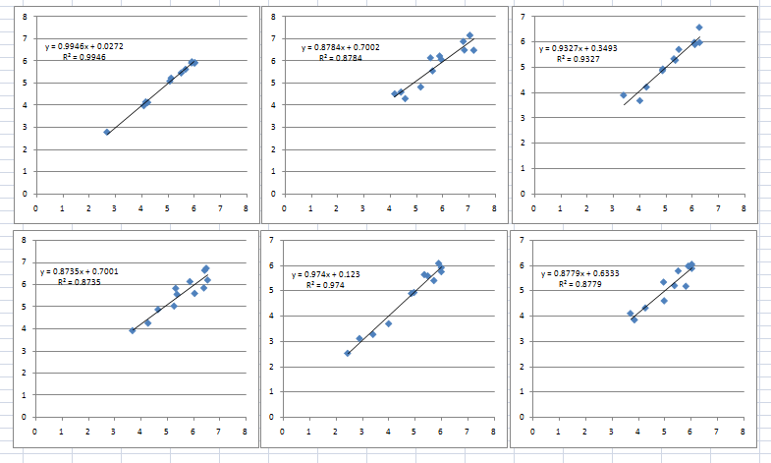
Validation
Bengbu Bozhou Fuyang
Huaibei Huainan Suzhou

Slide 15
Discussions
The best method
We think the method using k-NDVI & CFI& Meteorology is the best method
This method consider the fact of RS, Meteorology and technology improvement.
The average error of six prefecture in Huaibei Plain is about 0.2 ton per ha, this is a quite good result.

Slide 16
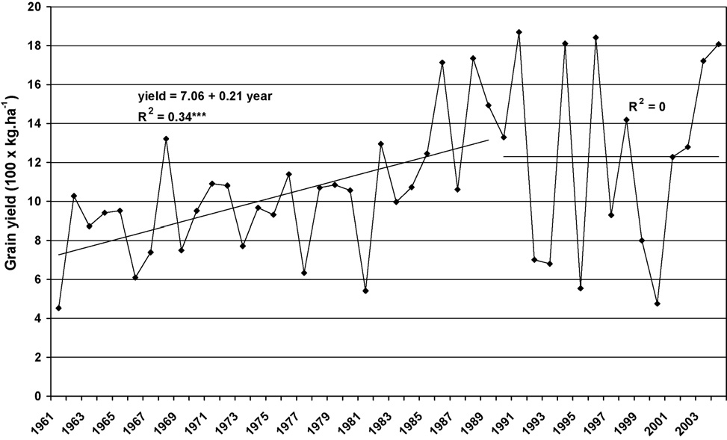
Discussions
The trend of crop yield
Anhui Province Morocco (Balaghi, 2008)

Slide 17
Discussions
Suggestion for further study
We want to use NOAA data to build a longer time sires data set (more than 20 years) .
Do some field work, get the real crop yield about the field level, then build the model of this level. This work I think can adjust our method and make the result more accurately.

Slide 18
谢谢
Grazie
Merci
Bedankt
شكرا

